Slide 1
A Voice for Autism
DEC1606-Micron, Adviser: Hegde
Cameron Cornick, Yiru Gao, Wen-Chi Hsu,
Zach Snyder, Ashlyn Freestone
Email: dec1606@iastate.edu

Slide 2
To get the Job done.
AAC (Assistive and Augmentative Communication) devices exist to allow people to communicate in more ways
Types range from “card readers” to high end tablets.
Requirements:
Functional:
Robust
User-Friendly
Power To Run All Day
Production Cost <$200
Database for usage
Secondary:
Adjustable to Age Level
Use Micron Memory

Slide 3
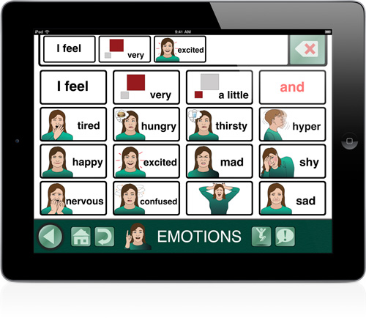
Doing something important
Many people can be unable to communicate.
Devices range in price from $500 up to $8500.
Can be clunky and not very easy to use.

Slide 4
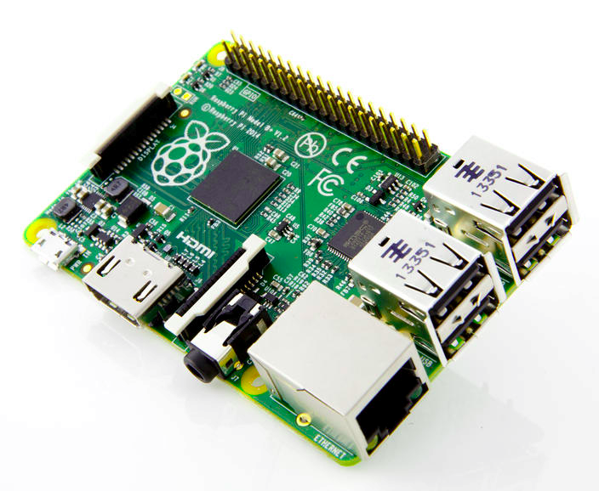
Where to start
“With something that works”
Starting Easy with examples
Prototypes -> Raspberry Pi
Short jumps in Code/Features
Build Something
Learn Something
Build Better Something

Slide 5
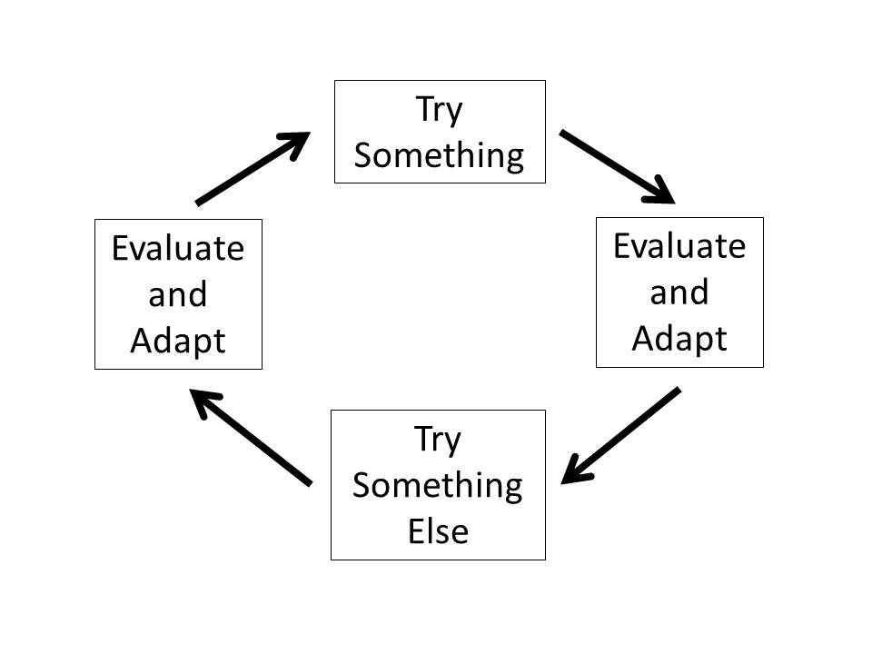
How to get there
Inclusivity
Everyone has a voice
Iterate
Build & Learn
Educate
Everyone Learns

